Slide 1

Stock Market Movement Prediction Using Economic Indicators, Technical Signals, and World Event Sentiment
DSC630 Term Project
Zicheng (Chance) Xu
May 31, 2025
Bellevue University

Slide 2
Introduction
Objective: Predict daily buy/sell signals for SPY ETF
Why? Stock market prediction is challenging but valuable
Approach: Combine economic data, technical indicators, and event sentiment
Key Question: Can diverse data sources improve short-term predictions?

Slide 3
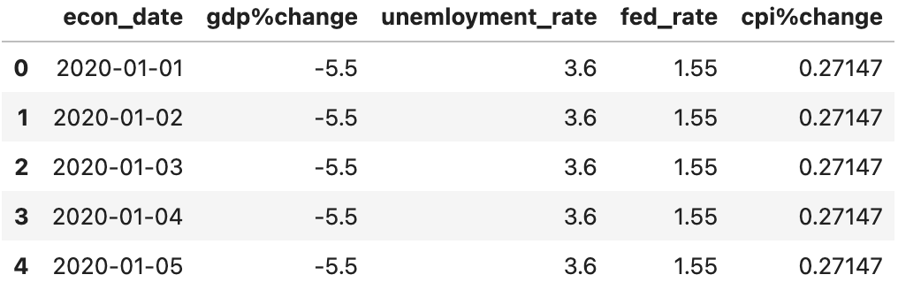
Data Sources
Economic Data (FRED): GDP, Unemployment, Federal Funds Rate, CPI
Stock Data (Yahoo Finance): SPY ETF daily prices, technical indicators
World Events (Wikipedia): Scraped events with NLP-derived sentiment scores
Date range: 2020 - 2024
Economic Data example

Slide 4
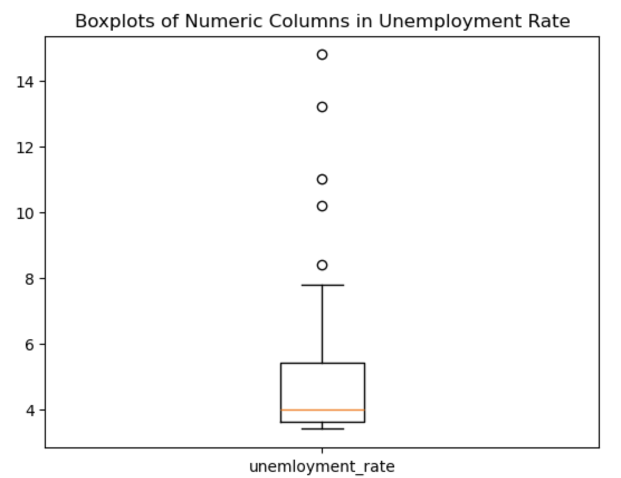
Economic Data Processing
Loaded CSV files from FRED
Renamed columns (e.g., A191RL1Q225SBEA to gdp%change)
Converted dates to datetime, forward-filled missing values
Validated outliers (e.g., 14.8% unemployment in April 2020)

Slide 5
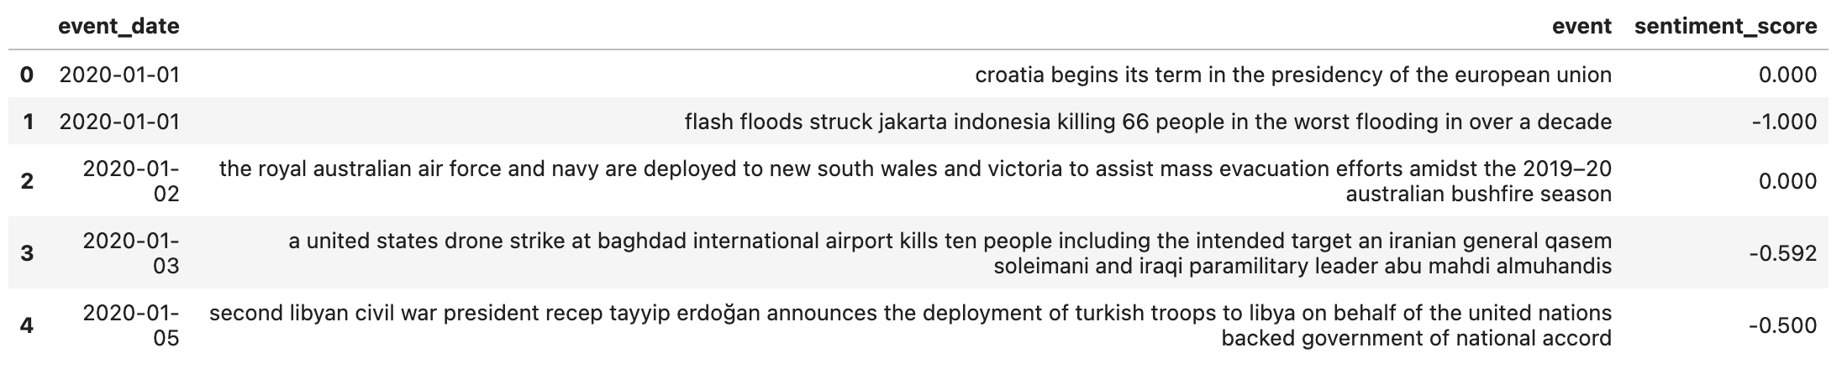
World Events Processing
Scraped Wikipedia pages (2020–2024) using BeautifulSoup
Extracted events under “Events” section, assigned sentiment scores
Averaged scores for days with multiple events, assigned 0 for no-event days

Slide 6
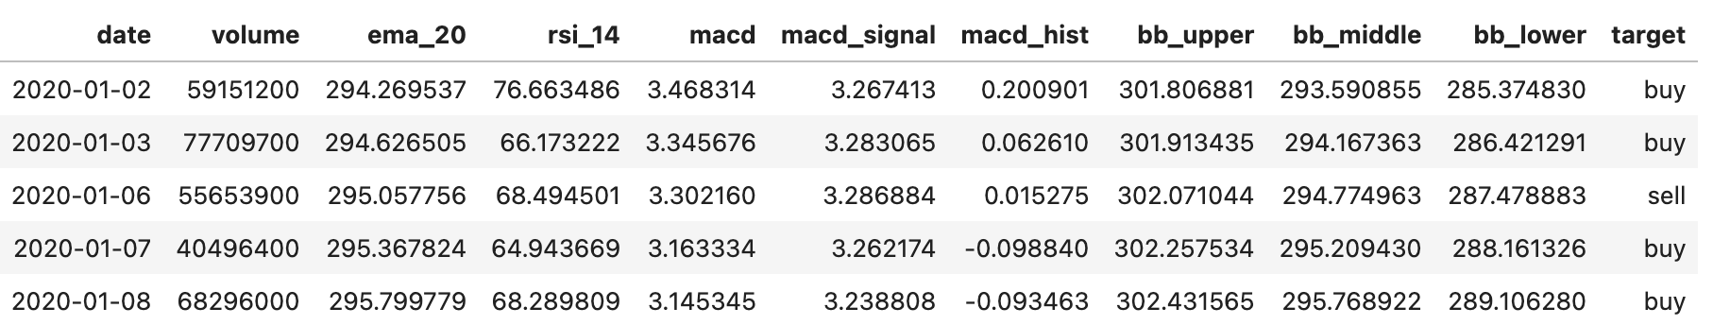
Stock Data Processing
Pulled SPY ETF data via yfinance (June 2019–Jan 2025)
Calculated technical indicators: EMA, RSI, MACD, Bollinger Bands
Derived target: Buy (next close > open), Sell (close ≤ open)

Slide 7
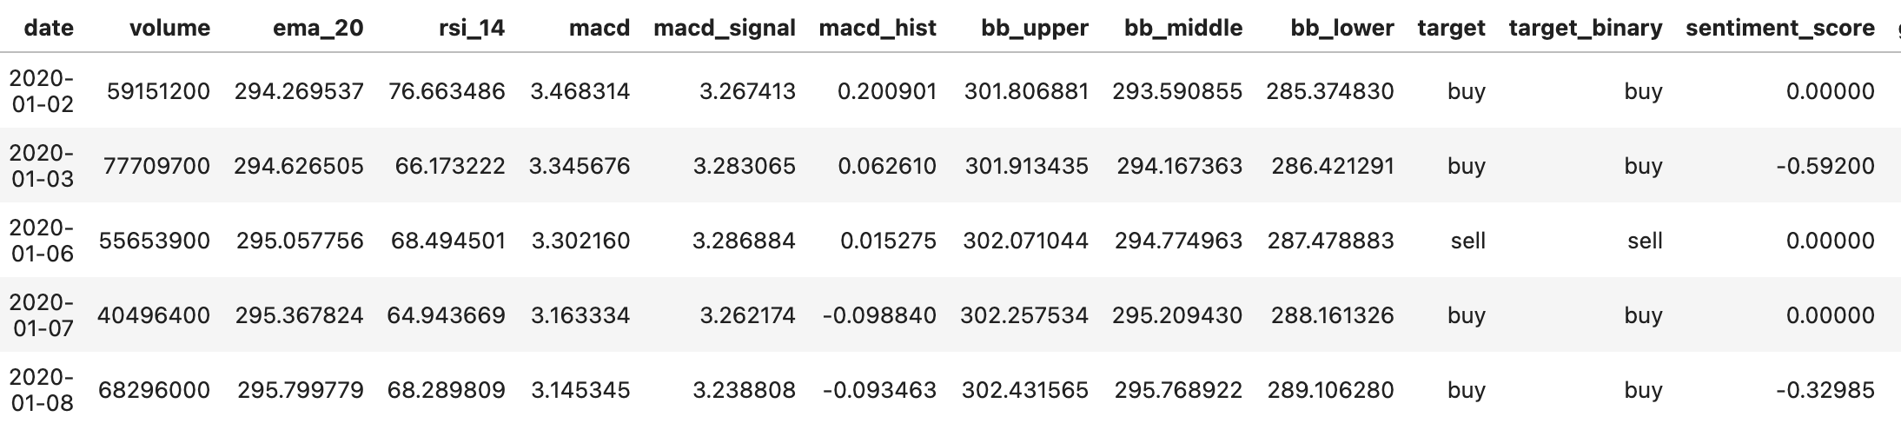
Data Merging
Left-joined stock data with economic and event data on date
Final DataFrame: 1,258 records, 17 features
Target distribution: 692 buy, 564 sell, 2 hold (merged hold with sell)

Slide 8
Modeling Approach
Models: Random Forest and XGBoost
Split: Training (2020–2023), Testing (2024)
Normalized features using MinMaxScaler
Hyperparameter tuning via GridSearchCV (F1-score)

Slide 9
Model Results
Random Forest: 50.4% accuracy, F1-score 0.49
  Best parameters: n_estimators=200, class_weight=balanced
XGBoost: 52.8% accuracy, F1-score 0.38
  Best parameters: learning_rate=0.01, max_depth=3
Random Forest selected for better F1-score

Slide 10
Key Findings
Technical indicators outperformed economic and sentiment features
Sentiment data limited by broad Wikipedia events
Models struggled with “sell” class prediction
Performance aligns with market efficiency (~50% baseline)

Slide 11
Recommendations & Ethics
Future Work: Use financial-specific sentiment (e.g., SeekingAlpha), explore LSTM models, compare to baseline strategies, explore real-time high frequency trading algos
Ethical Concerns: Misuse risk, sentiment bias, transparency, access disparity
Emphasized educational use and transparent methodology

Slide 12
Conclusion
Integrated diverse data sources into a cohesive model
Achieved modest predictive power, valuable with risk management
Laid groundwork for future enhancements in financial prediction

